Slide 1



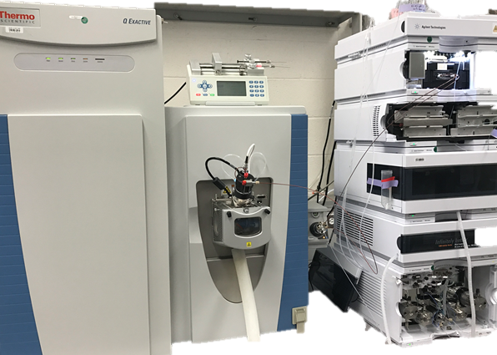
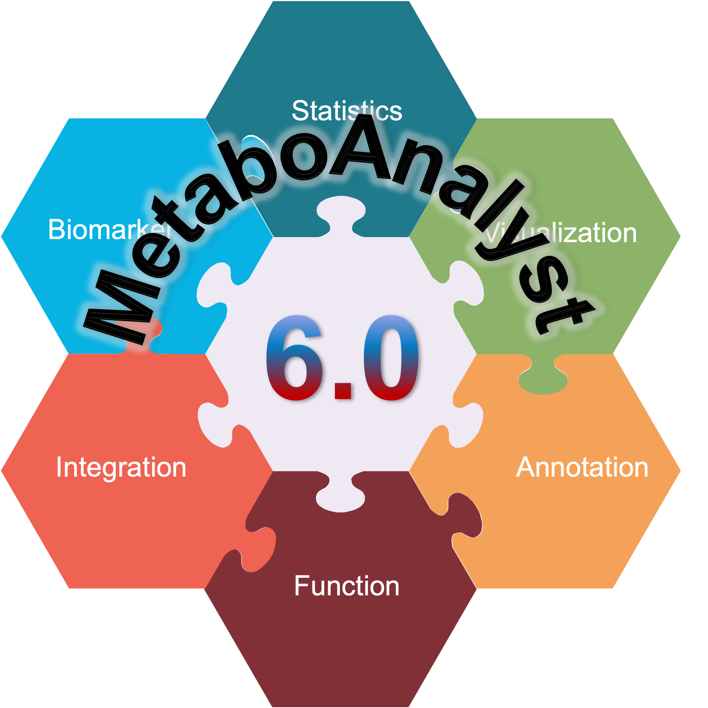
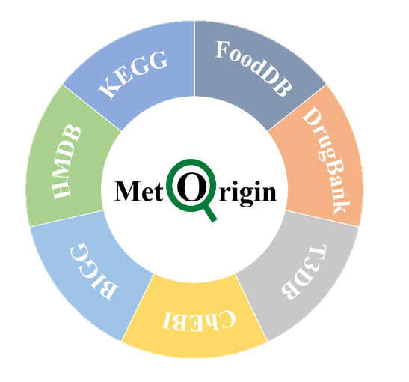
Plasma Microbial-Derived Metabolites Predict Traumatic Injury Outcome
Sinha, S.¹, Oft, H.C.M.², Kar, U.K.¹, Simon, D.³, Sperry, J.L.¹, & Billiar, T.R. ¹
¹Department of Surgery, University of Pittsburgh
²Medical Scientist Training Program, University of Pittsburgh School of Medicine
³UPMC Children’s Hospital of Pittsburgh
BACKGROUND
RESULTS
CONCLUSIONS & SIGNIFICANCE
Non-resolvers
Traumatic injury is a leading cause of death worldwide
The Prehospital Air Medical Plasma (PAMPer) trial identified the benefit of prehospital thawed plasma on thirty-day mortality¹
Circulating microbial-derived metabolite changes are unexplored in trauma
These metabolites play a major role in the gut-brain axis, as signaling molecules, and as toxins
Pathways
Resolvers
Our investigation suggests that microbial metabolites play a vital role in the host response to trauma
We reveal several pathways and metabolites of potential interest
These biomarkers predict eventual patient outcome at 24 hours post-ED admission
Validation in SWAT, a separate trauma dataset, supports biomarker relevance
Future mechanistic studies should be performed to determine the role of these metabolites in the host response
Fig. 1. Differentially expressed pathways influenced by microbial metabolites in PAMPer. Effects of trauma on circulating microbial metabolites impact pathways such as tryptophan catabolism and BCAA catabolism.
METHODS
a
b
Sample collection (PAMPer, SWAT)
Metabolomics (Metabolon, Inc.)
LIMITATIONS
The untargeted metabolomics assays captured only a subset of the total circulating metabolome, and microbe-metabolite links are still incomplete; thus, our study does not represent all microbial metabolites
Human response to trauma is diverse even within similar demographics, and generalizing results must be done with caution.
Fig. 2. Microbial metabolites classify patient resolution well at 24 hrs in PAMPer and SWAT. a PLS-DA model trained on all n=143 microbial metabolites discriminates well between non-resolvers and resolvers at 24 hrs in both PAMPer and SWAT. b Top 10 PLS-DA ranked microbial metabolites in contribution to classification.
a
b
REFERENCES & ACKNOWLEDGEMENTS
Statistical analysis (R, MetaboAnalyst)
Origin analysis (MetOrigin²)
Sperry JL, Guyette FX, Brown JB, Yazer MH, Triulzi DJ, Early-Young BJ, Adams PW, Daley BJ, Miller RS, Harbrecht BG, Claridge JA. Prehospital plasma during air medical transport in trauma patients at risk for hemorrhagic shock. New England Journal of Medicine. 2018 Jul 26;379(4):315-26.
Yu G, Xu C, Zhang D, Ju F, Ni Y. MetOrigin: discriminating the origins of microbial metabolites for integrative analysis of the gut microbiome and metabolome. IMeta. 2022 Mar;1(1):e10.
Wishart DS, Oler E, Peters H, Guo A, Girod S, Han S, Saha S, Lui VW, LeVatte M, Gautam V, Kaddurah-Daouk R. MiMeDB: the human microbial metabolome database. Nucleic Acids Research. 2023 Jan 6;51(D1):D611-20.
Neveu V, Nicolas G, Amara A, Salek RM, Scalbert A. The human microbial exposome: expanding the Exposome-Explorer database with gut microbial metabolites. Scientific Reports. 2023 Feb 2;13(1):1946.
Sperry JL, Early B, Buck M, Silfies L. Shock, whole blood and assessment of TBI (SWAT). Pittsburgh, PA: University of Pittsburgh. 2018.
Author Contribution Statement: SS designed poster and generated data in Figs. 2 and 3. HCMO generated data in Fig. 1. UKK, DS, JLS, and TRB conceptualized the study and oversaw design, execution, and funding.
Disclosures: This research was supported by DoD Contract No. W81XWH-16-D-0024, Task Order W81XWH-16-D-0024-0002, and NIH R01NS127372. Any opinions or recommendations expressed in this material are those of the authors and do not necessarily reflect the views of the Department of Defense.
PAMPer 24 hrs
SWAT 24 hrs
We analyzed 143 microbial metabolites in 144-198 PAMPer patients
MetOrigin-identified microbial metabolites were cross-checked with MimeDB³ and Exposome-Explorer⁴ and subjected to literature review
The SWAT Cohort⁵ served as a validation set
Fig. 3. Limited microbial metabolites can predict patient resolution at 24 hrs in PAMPer and SWAT. a Logistic regression model with only one and two metabolites discriminates well between resolvers and non-resolvers at 24 hrs in PAMPer. b This performance is validated in SWAT at 24 hrs, indicating significance of metabolites in patient outcome.
Notes:
PAMPer https://www.tandfonline.com/doi/full/10.3109/10903127.2014.995851
Yu G, Xu C, Zhang D, Ju F, Ni Y. MetOrigin: discriminating the origins of microbial metabolites for integrative analysis of the gut microbiome and metabolome. IMeta. 2022 Mar;1(1):e10.

